Slide 1


Emotion Kids
Tigau-Almasan Alexandra
Gorgos Andreea
Corman Robert

Slide 2
Gant diagram
Oct 3 - Oct 17
Workflow & Description
Oct 17 - Oct 31
Intelligent Algorithm with small data
Oct 31 - Nov 14
Intelligent Algorithm with real data
Oct 31 - Nov 14
Documentation for algorithm and results
Nov 14 - Nov 28
Intelligent Algorithm Integration
Nov 14 - Nov 28
Documentation - wiki/ontology/mindmap
Nov 28 - Dec 12
Algorithm Improvement
All Scientific Documentation
Dec 12 - Jan 16
Jan 16
Presentation
2019
2020
Oct
Nov
Dec
Jan
2020
Today

Slide 3

Datasets
FER2013
CAFFE
Videos
Notes:
We used 2 db sets: FER 2013 that is a DB with images with adult persons. The second db is CAFFE and it contains only images with kids of different genders, nationality and skins. They are both kept locally on each of us’s laptop and the algorithm was trained with each of them. It is local because we don’t need to wait for a connection, all of them require internet connection.
All the data from this 2 db’s represent images that can be open with any tool, even the ones predefined with the computer. Besides images we also have videos

Slide 4



Visualisation of the datasets
Notes:
First dataset, FER2013, had its data as a CSV file, and we visualized them using python (matplotlib)

Slide 5

Versioning tools
GIT

Slide 6
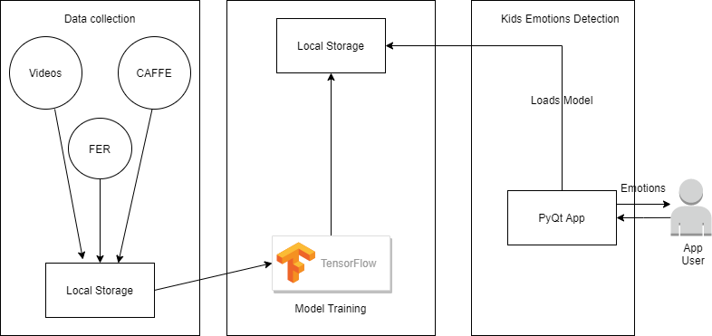
Architecture

Slide 7

Training: offline
Inference: dynamic
AI component serving pickle
Notes:
Pickle to save the neural network model

Slide 8
Pipeline diagram
Surprised
Happy
Input Face Image
Preprocessing
Feature Extraction
Sad
Classification
Angry
Database Face Image
Preprocessing
Feature Extraction
Fearful
Disgusted
Neutral
Notes:
Preprocessing refers to all the actions that can be made in order to enhance the performance of our system and it can be carried out before the feature extraction process.
It usually refers to different types of processes such as:
- image clarity and scaling,
- contrast adjustment,
- additional enhancement processes
- cropping and scaling processes
- normalization designed for reduction of illumination and variations of the face images or for determining the eye position
Feature extraction is finding and depicting of positive features of concern within an image for further processing.
Classification is the final stage of FER system in which the classifier categorizes the expression such as smile, sad, surprise, anger, fear, disgust and neutral.

Slide 9




Libraries used
Notes:
As libraries we used:
- TensorFlow (training the model)
TensorFlow Keras (define the model)
Numpy for computation
PYQT5

Slide 10
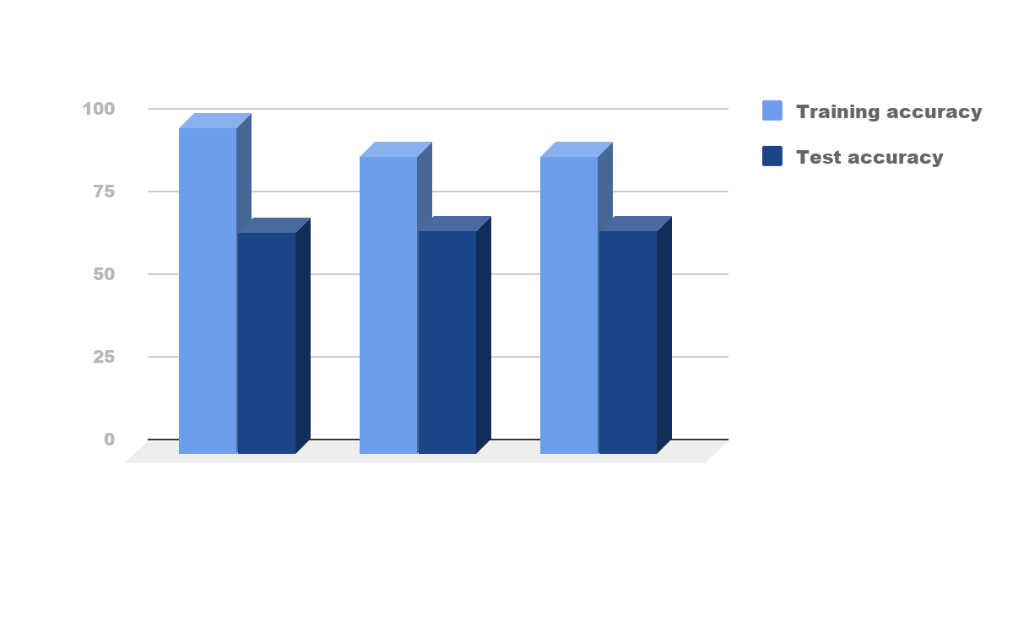
Results

Slide 11



Philosophical aspects: Social impact
Help teachers understand children’s emotion during activities
Useful to identify what makes them happy
Discover what emotions they can feel or mimic
Developing their EQ

Slide 12

Philosophical aspects: Ethics
Photographs are a valuable but potentially harmful resource
Informed consent is required, its form may vary by context
Accuracy of the results is vital when using AI tools as deciding factors

Slide 13
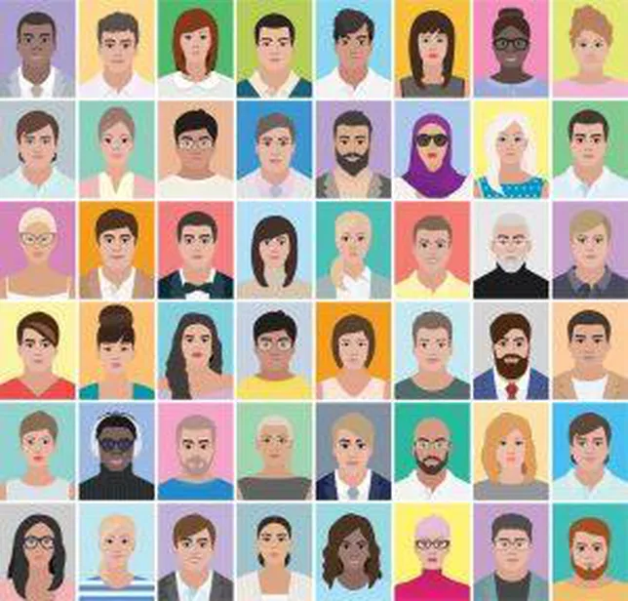
Philosophical aspects: Fairness
Facial Recognition technology is still prone to errors:
is assigning more negative emotions to black faces than to white faces
often fails to correctly recognize the gender of the faces with darker skin

Slide 14

Demo

Slide 15
Bibliography
https://machinelearningmastery.com/introduction-python-deep-learning-library-tensorflow/
I.Michael Revina, W.R. Sam Emmanuel A Survey on Human Face Expression Recognition Techniques. Journal of King Saud University - Computer and Information Sciences September 2018, pp 2 https://doi.org/10.1016/j.jksuci.2018.09.002
Elgiz Bal, Emily Harden, Damon Lamb, Amy Vaughan Van Hecke, John W. Denver, Stephen W. Porges Emotion Recognition in Children with Autism Spectrum Disorders: Relations to Eye Gaze and Autonomic State. Journal of Autism and Developmental Disorders March 2010, Volume 40, Issue 3, pp 358-370 https://doi.org/10.1007/s10803-009-0884-3
Vanessa LoBue and Cat Thrasher The Child Affective Facial Expression (CAFE) set: validity and reliability from untrained adults. Frontiers in Emotion Science, Psychology, 2015. https://doi.org/10.3389/fpsyg.2014.01532

Slide 16
Thank you!

